Slide 1

AUTOMATIC DETECTION OF MANGOS USING THERMAL IMAGING
BTP Code: B23RVP01
Team members
E.Jaswanth Krishna - S20200020257
A.Gopal Reddy - S20200020248
Mentor -Dr Raja Vara Prasad Y

Slide 2
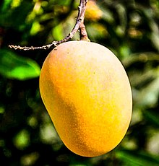
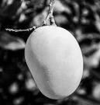
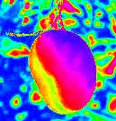
Motivation and introduction
Mangoes have a unique shape, texture, and color that make them easily distinguishable from other fruits. This makes them an ideal candidate for object detection algorithms that rely on these visual features to identify objects.
Object detection is essential for many applications like crop monitoring and disease prediction etc.,
Benefits of Thermal imaging:
Thermal imaging can differentiate between objects based on their heat signatures, which can improve the accuracy of object detection
It can detect the objects in low light conditions also.
figure(1) . conversion of RGB to thermal image

Slide 3
Existing models
Author name | Title | Method | Disadvantages
Mohd Ali M, Hashim N, Abd Aziz S, Lasekan O. | Characterisation of Pineapple Cultivars under Different Storage Conditions Using Infrared Thermal Imaging Coupled with Machine Learning Algorithms. | K-Nearest Neighbour(kNN) Decision tree(DT), Naive Bayesian classification, Linear Discriminant Analysis(LDA) Quadratic Discriminant Analysis(QDA) Support Vector Machine (SVM) | Classifier model is overfitting the data
Naik S, Patel B. | Thermal imaging with fuzzy classifier for maturity and size based non-destructive mango (Mangifera Indica L.) grading. | Fuzzy classifier | Classification is always done with the comparison between 2 Mangos.
Bhole V, Kumar A. | Mango quality grading using deep learning technique: Perspectives from agriculture and food industry. | CNN based SqueezeNet Model | Small data set is used to train the model
Table(1).Existing Methods and disadvantages

Slide 4
Characterisation of Pineapple Cultivars under Different Storage Conditions Using Infrared Thermal Imaging.
Data Collection:
3 types of Pineapples(MD2, Morris, and Josapine) are being chosen for building a model for classification with a dataset of 1080 images.
14 features are being extracted from the thermal images.
Models:
Different algorithms are being used K-Nearest Neighbour(kNN) , Decision tree(DT) and Naive Bayesian classification,Linear Discriminant Analysis(LDA),Quadratic Discriminant Analysis(QDA),Support Vector Machine (SVM)
SVM had given better accuracy than remaining classifier with an accuracy of 100%.
Disadvantages:
Data set is small so that the classifier is overfitting the data.
To deal with larger dataset CNN models can be used , this can also resolve overfitting issues.

Slide 5
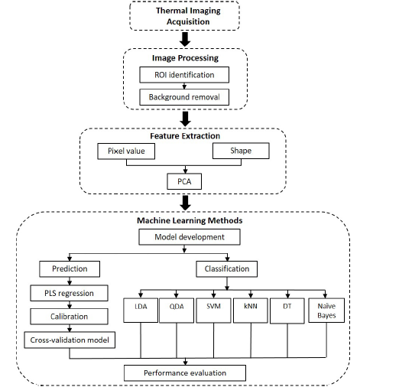
figure(2).[1]Process flow of classification and prediction

Slide 6
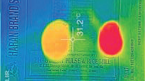
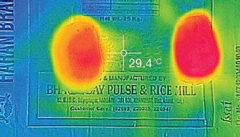
Thermal imaging with fuzzy classifier for maturity and size based non-destructive mango (Mangifera Indica L.) grading
Data collection :
Image consist of 2 mangos , with one ripen mango as reference.
5 features are extracted from the images.
Method:
Fuzzy classifier is used for Classification of mangos into 2 grades.
Fuzzy classifiers are particularly useful when dealing with data that is difficult to quantify or measure precisely.
They have used Fuzzy classifier to size of the fruit from extracted features.
figure(3).[2]sample of dataset

Slide 7
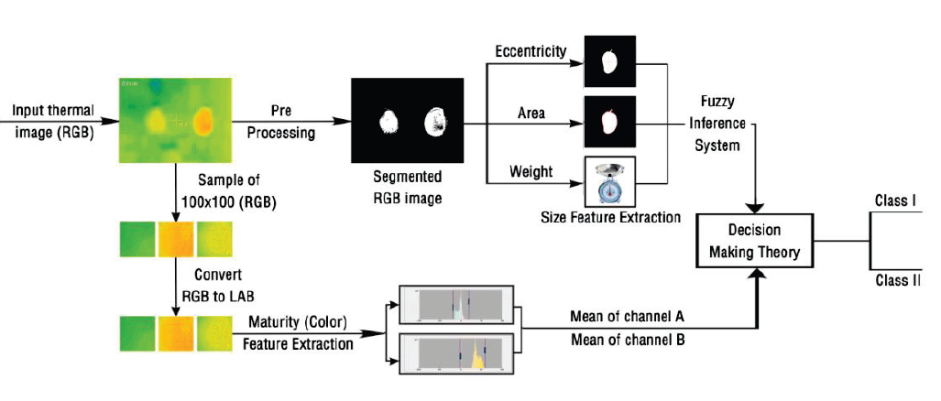
figure(4).[2]Process flow of Mango Classification

Slide 8
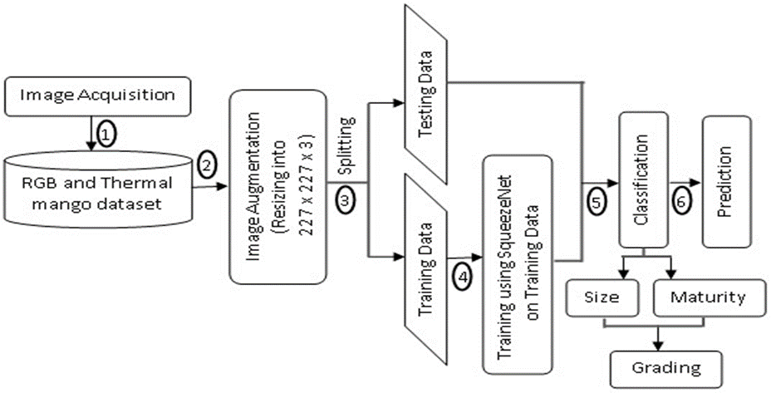
Mango Quality Grading using Deep Learning Technique: Perspectives from Agriculture and Food Industry
Data set contains RGB images of mangos of type kesar and take parameters like
Size,maturity to Grade the mangos.
CNN based squeezeNet model was used while training the data.
figure(5).[3]process flow of classification

Slide 9
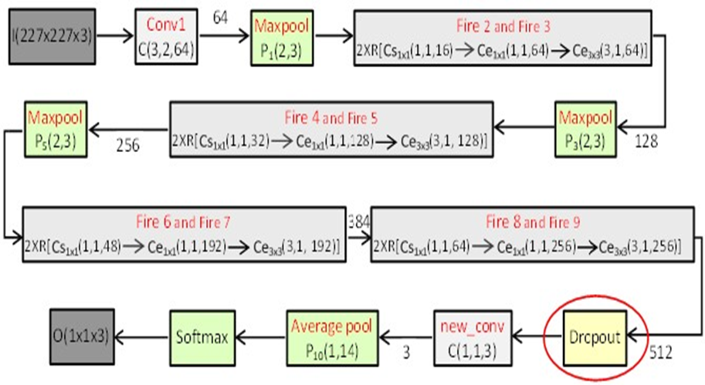
figure(6).[3]Squeeze Net Model
The SqueezeNet incorporates total 68 layers which
is 18 layers deep coupled with 72 connections.
Disadvantages:
Thermal images have less accuracy compared
to RGB images.
Data set is small.
Image Type | Accuracy | Training Time
RGB Maturity | 97% | 30 min
Thermal Maturity | 94% | 7 min
Table(2) Comparison table

Slide 10
Summary of the literature
At the initial stage machine learning algorithms are being used for object detection on RGB images.
With small data set they have performed good
As the data set is increasing with various categories of fruits.
We need to use Deep learning models for fast computation and better accuracy of detecting objects

Slide 11
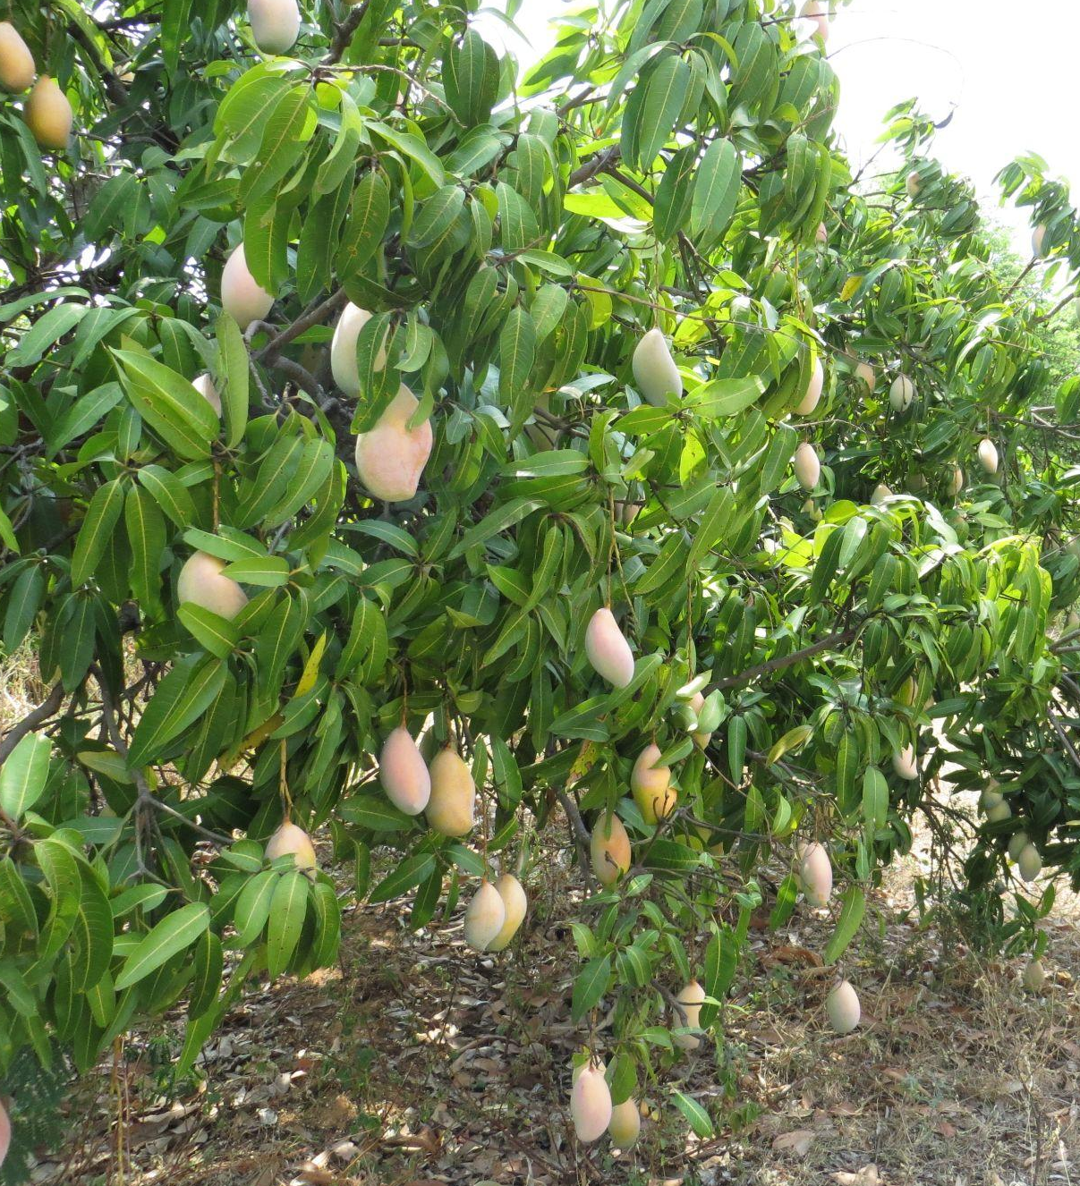
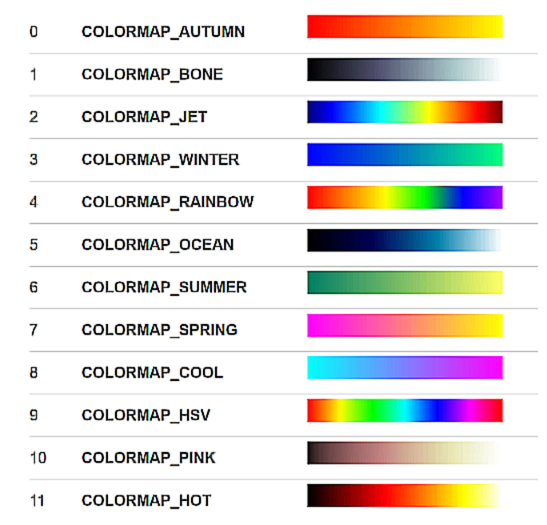
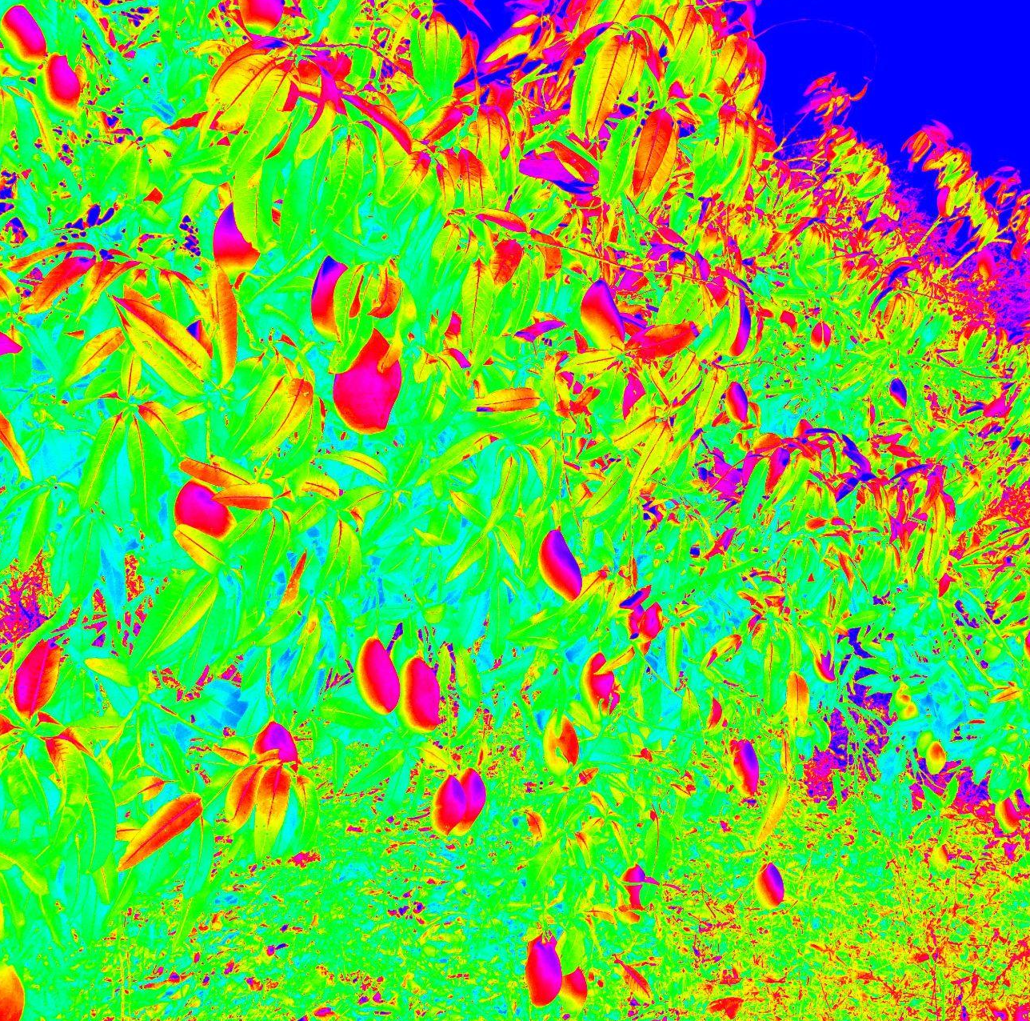
Publicly available mango data
RGB Image
Thermal image
Libraries used
Figure(7).Conversion of RGB image to Thermal image

Slide 12
Timeline of BTP
Stage 4
Proposed CV model for mango detection in thermal imaging
4
Stage 3
Comparison of existing models with RGB and Thermal imaging
3
Stage 2
Literature
Data Pre processing
Mango detection using existing CV models
2
Stage 1
Literature
Data Collection
1

Slide 13
Conclusion
We have done literature on fruit detection and classification using thermal images.
At the early stage we are trying to convert RGB to thermal image and we are working some basic CNN models for detection of mangoes in the obtained thermal images.

Slide 14
Reference Papers:
Mohd Ali M, Hashim N, Abd Aziz S, Lasekan O. Characterisation of Pineapple Cultivars under Different Storage Conditions Using Infrared Thermal Imaging Coupled with Machine Learning Algorithms. Agriculture. 2022 Jul 13;12(7):1013.
Naik S, Patel B. Thermal imaging with fuzzy classifier for maturity and size based non-destructive mango (Mangifera Indica L.) grading. In2017 International Conference on Emerging Trends & Innovation in ICT (ICEI) 2017 Feb 3 (pp. 15-20). IEEE.
Bhole V, Kumar A. Mango quality grading using deep learning technique: Perspectives from agriculture and food industry. InProceedings of the 21st annual conference on information technology education 2020 Oct 7 (pp. 180-186).

Slide 15
THANK YOU

